Slide 1
The Physical Layer
Chapter 2

Slide 2
Theoretical Basis for Data Communication
Fourier analysis
Bandwidth-limited signals
Maximum data rate of a channel

Slide 3
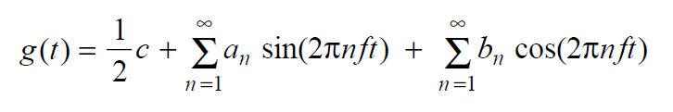
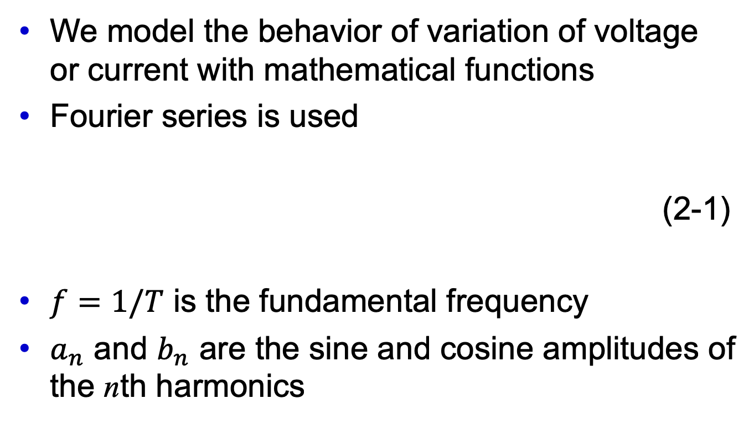
Fourier Analysis
We model the behavior of variation of voltage or current with mathematical functions
Fourier series is used
(2-1)
$f=1/T$ is the fundamental frequency
$a_{n}$ and $b_{n}$ are the sine and cosine amplitudes of the nth harmonics

Slide 4
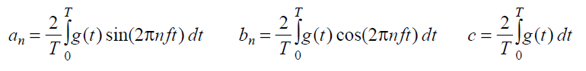
Fourier Analysis
A data signal that has a finite duration can be handled by imagining that it repeats the entire pattern with period T.
Function reconstructed with

Slide 5
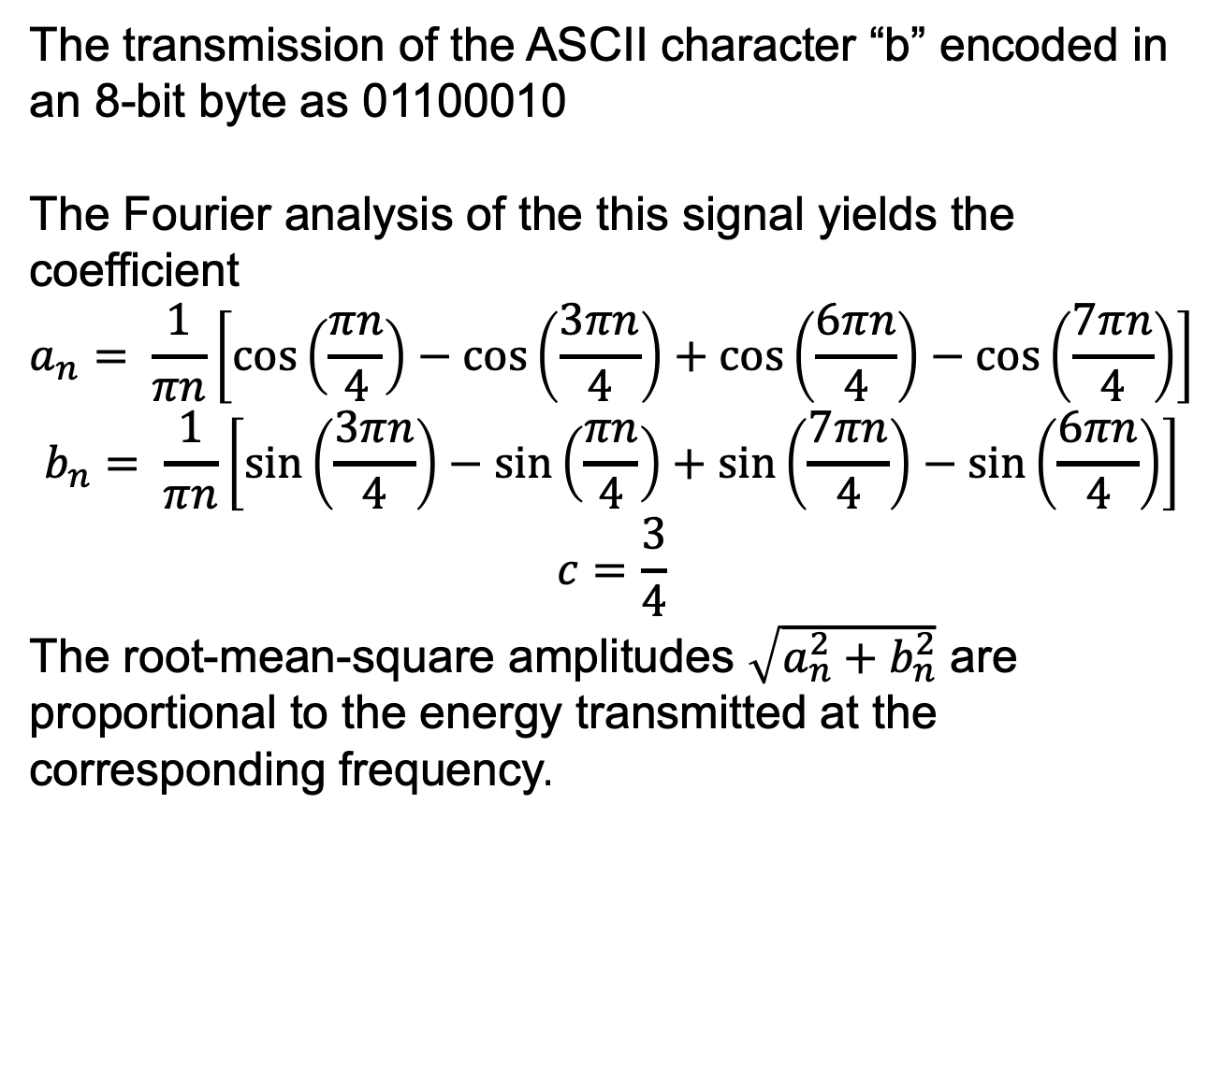
Bandwidth-Limited Signals
The transmission of the ASCII character “b” encoded in an 8-bit byte as 01100010
The Fourier analysis of the this signal yields the coefficient
$$a_{n}= \frac{1}{πn}\left[\cos\left(\frac{πn}{4}\right)−\cos\left(\frac{3πn}{4}\right)+\cos\left(\frac{6πn}{4}\right)−\cos\left(\frac{7πn}{4}\right)\right]$$
$$b_{n}= \frac{1}{πn}\left[\sin\left(\frac{3πn}{4}\right)−\sin\left(\frac{πn}{4}\right)+\sin\left(\frac{7πn}{4}\right)−\sin\left(\frac{6πn}{4}\right)\right]$$
$$c=\frac{3}{4}$$
The root-mean-square amplitudes $\sqrt{a_{n}^{2}+b_{n}^{2}}$ are proportional to the energy transmitted at the corresponding frequency.

Slide 6
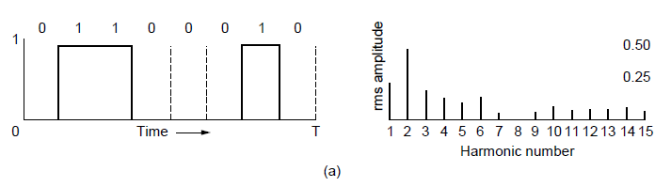
Bandwidth-Limited Signals
A binary signal and its root-mean-square Fourier amplitudes.

Slide 7
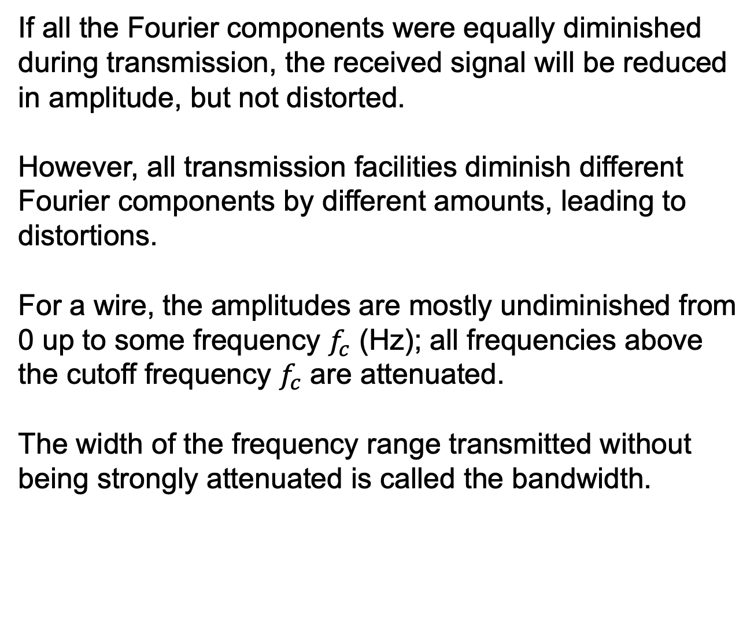
Bandwidth-Limited Signals
If all the Fourier components were equally diminished during transmission, the received signal will be reduced in amplitude, but not distorted.
However, all transmission facilities diminish different Fourier components by different amounts, leading to distortions.
For a wire, the amplitudes are mostly undiminished from 0 up to some frequency $f_{c}$ (Hz); all frequencies above the cutoff frequency $f_{c}$ are attenuated.
The width of the frequency range transmitted without being strongly attenuated is called the bandwidth.

Slide 8
Bandwidth-Limited Signals
The bandwidth depends on the physical property of the transmission medium, e.g., the construction, thickness, and length of the wire.
For signals that do not start at zero, the bandwidth is still the width of the band of frequencies that are passed
The information carried only depends on the bandwidth and not the starting and ending frequencies
Baseband signals: 0 ~ maximum frequency
Passband signals: minimum frequency (non-zero) ~ maximum frequency

Slide 9
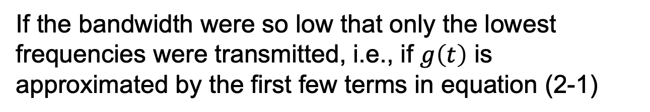
Bandwidth-Limited Signals
If the bandwidth were so low that only the lowest frequencies were transmitted, i.e., if $g\left(t\right)$ is approximated by the first few terms in equation (2-1)

Slide 10
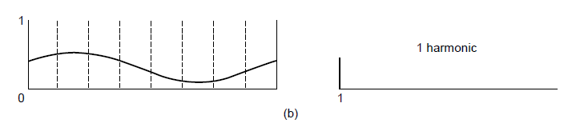
Bandwidth-Limited Signals
(b)-(e) Successive approximations to the original signal.

Slide 11
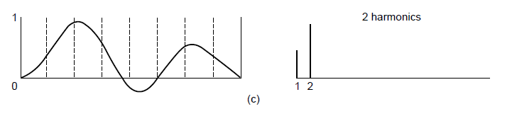
Bandwidth-Limited Signals
(b)-(e) Successive approximations to the original signal.

Slide 12
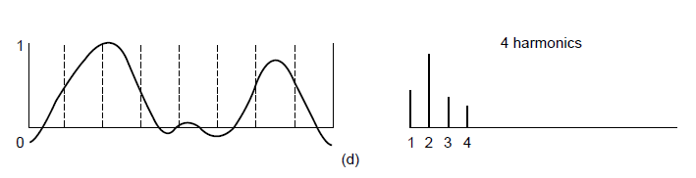
Bandwidth-Limited Signals
(b)-(e) Successive approximations to the original signal.

Slide 13
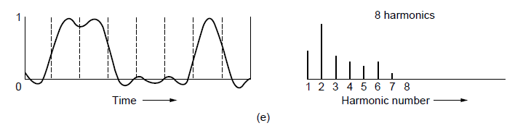
Bandwidth-Limited Signals
(b)-(e) Successive approximations to the original signal.

Slide 14
Bandwidth-Limited Signals
For digital transmission, the goal is to receive a signal with just enough fidelity to reconstruct the sequence of sending bits
Fig.(e) can already do this, so it is wasteful to use more harmonics to receive a more accurate replica

Slide 15
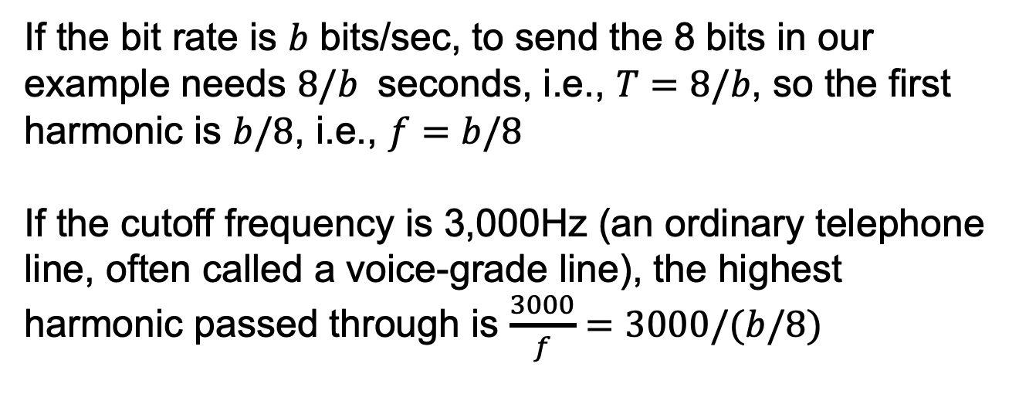
Bandwidth-Limited Signals
If the bit rate is $b$ bits/sec, to send the 8 bits in our example needs $8/b$ seconds, i.e., $T=8/b$, so the first harmonic is $b/8$, i.e., $f=b/8$
If the cutoff frequency is 3,000Hz (an ordinary telephone line, often called a voice-grade line), the highest harmonic passed through is $\frac{3000}{f}=3000/(b/8)$

Slide 16
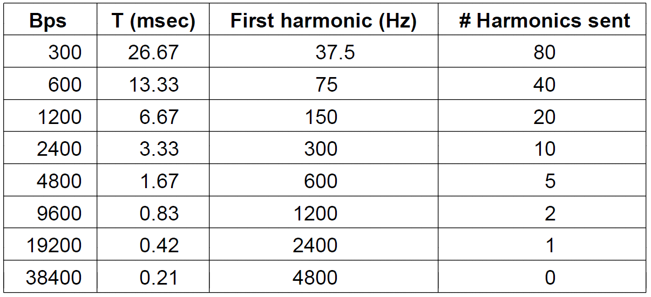
Bandwidth-Limited Signals
Relation between data rate and harmonics for our example.

Slide 17
Bandwidth-Limited Signals
From the table we can see that, if the data rates are higher than 38.4 kbps, 0 harmonics can be sent, and no signals can be reconstructed, even if the channel is noiseless.
Limiting the bandwidth (3,000kHz) limits the data rate (<38.4)
Some coding schemes that use more than two voltage levels may achieve higher data rates (introduced later)

Slide 18
Bandwidth-Limited Signals
Bandwidth clarification
Analog bandwidth, measured in Hz, means the cutoff frequency of a transmission medium
Digital bandwidth, measured in bits/sec, means the maximum data rate of a channel
It will be clear from the context when we mean the analog bandwidth or the digital bandwidth

Slide 19
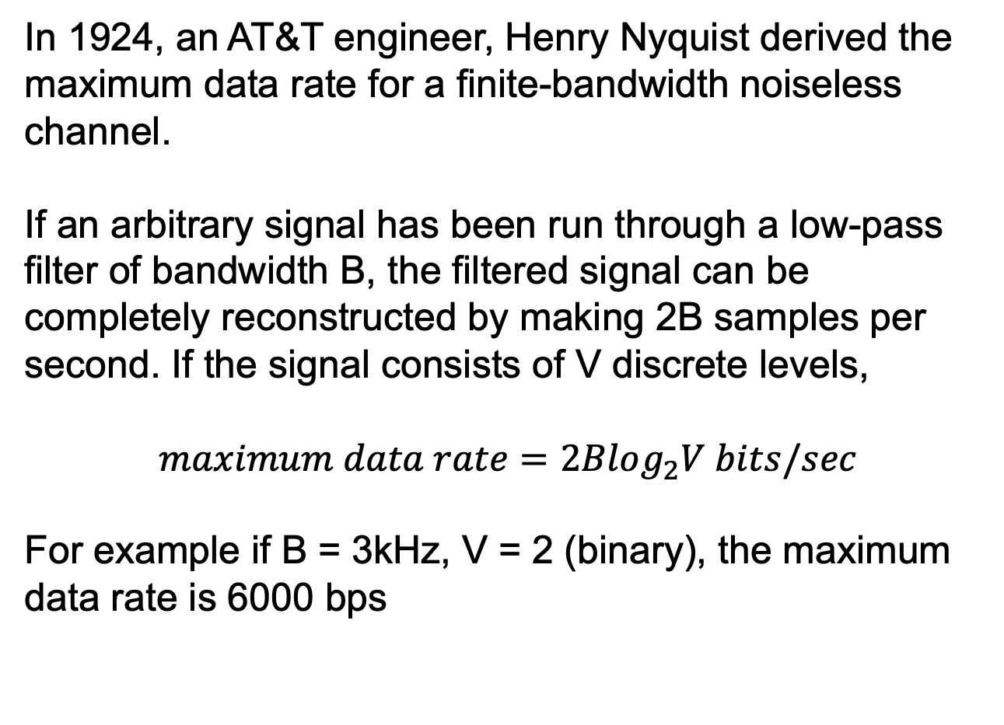
The Maximum Data Rate of a Channel
In 1924, an AT&T engineer, Henry Nyquist derived the maximum data rate for a finite-bandwidth noiseless channel.
If an arbitrary signal has been run through a low-pass filter of bandwidth B, the filtered signal can be completely reconstructed by making 2B samples per second. If the signal consists of V discrete levels,
$$maximum data rate=2Blog_{2}V bits/sec$$
For example if B = 3kHz, V = 2 (binary), the maximum data rate is 6000 bps

Slide 20
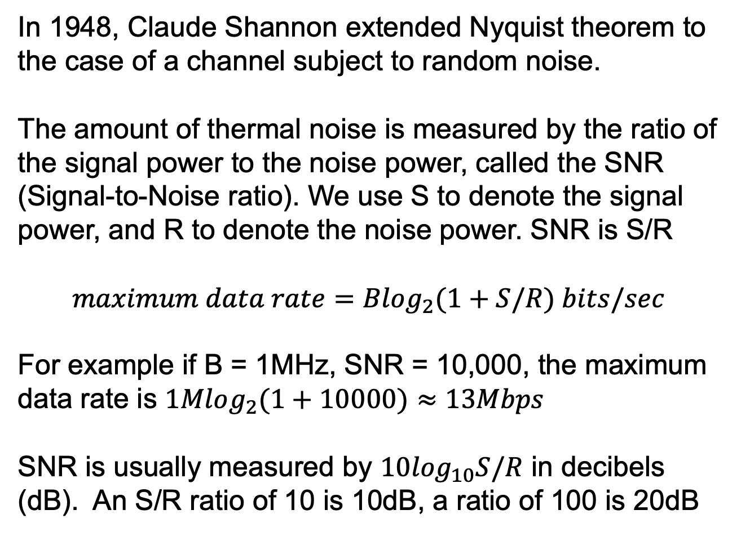
The Maximum Data Rate of a Channel
In 1948, Claude Shannon extended Nyquist theorem to the case of a channel subject to random noise.
The amount of thermal noise is measured by the ratio of the signal power to the noise power, called the SNR (Signal-to-Noise ratio). We use S to denote the signal power, and R to denote the noise power. SNR is S/R
$$maximum data rate=Blog_{2}(1+S/R) bits/sec$$
For example if B = 1MHz, SNR = 10,000, the maximum data rate is $1Mlog_{2}(1+10000)≈13Mbps$
SNR is usually measured by $10\log_{10}S/R$ in decibels (dB). An S/R ratio of 10 is 10dB, a ratio of 100 is 20dB

Slide 21
The Maximum Data Rate of a Channel
Shannon’s result was derived from information theory, and applies to any channel subject to thermal noise.
There is always thermal noise due to the motion of the molecules in the system.
To improve the maximum data rate of a channel, we either improve the SNR or use more bandwidth.

Slide 22
Transmission Media
Each physical media has its own bandwidth, delay, cost and ease of installation and maintenance.
Guided media, such as copper wire and fiber optics
Unguided media, such as terrestrial wireless, satellite and lasers through the air

Slide 23
Guided Transmission Media
Magnetic media
Twisted pairs
Coaxial cable
Power lines
Fiber optics

Slide 24
Magnetic Media
Write data onto magnetic media
Disks
Tapes
Data transmission speed
Never underestimate the bandwidth of a station wagon full of tapes hurtling down the highway.

Slide 25
Magnetic Media
Speed:
An industry-standard Ultrium tape can hold 800 gigabytes
A box 60*60*60 cm can hold about 1000 such tapes, for a total capacity of 800 terabytes, or 6400 terabits
A box of tapes can be delivered anywhere in the United States in 24 hours by express companies, such that the data rate is 6400 terabits/86400 sec = 70 Gbps
No computer network can even approach this.

Slide 26
Magnetic Media
Cost:
The cost of an Ultrium tape is $40
A tape can be reused at least 10 times, so the cost is 40*1000/10 = $4000 per box per usage
Add another $1000 for shipping
We have a cost of $5000 to ship 800 TB, i.e., shipping a gigabyte for a little over half a cent
No computer network can beat this.

Slide 27
Magnetic Media
The biggest problem with magnetic media is delay.

Slide 28
Twisted Pairs
The most common transmission media
A twisted pair consists of two insulated copper wires, typically 1 mm thick
The wires are twisted to avoid energy radiation.
A signal is usually carried as the difference in voltage between the two wires; better immunity to external noise because the noise tends to affect both wires the same, leaving the differential unchanged

Slide 29
Twisted Pairs
Application: telephone system
Both telephone calls and ADSL Internet access run over twisted pairs
Twisted pairs can run several km without amplification; for longer distances the signal becomes too attenuated and repeaters are needed
Twisted pairs can be bundled together and encased in a protective sheath

Slide 30
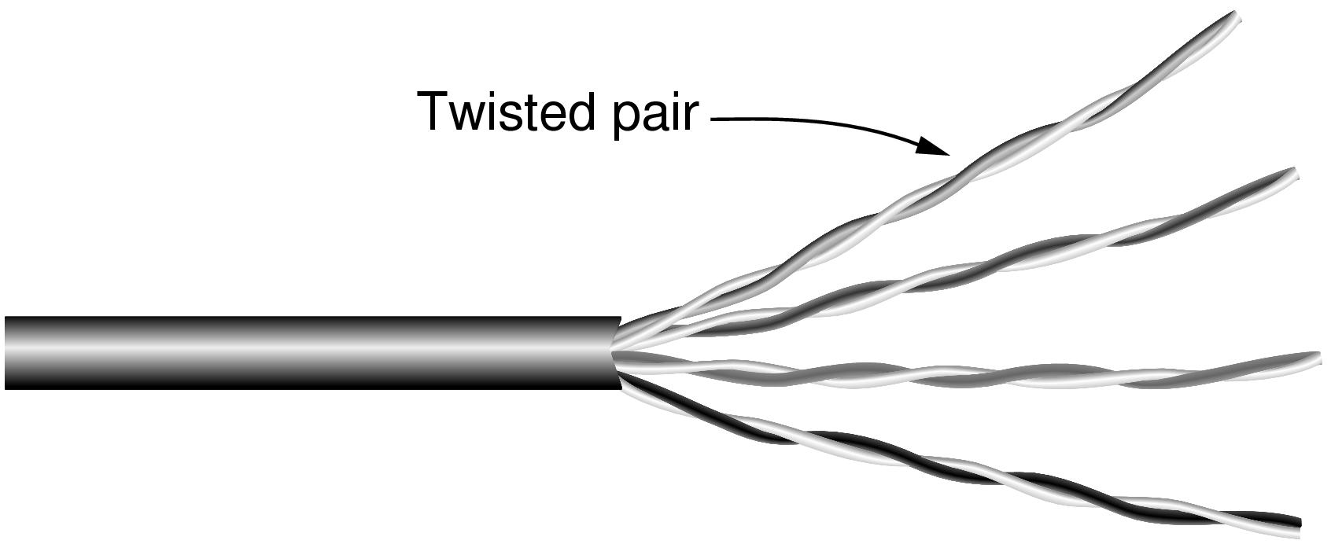
Twisted Pairs
Category 5 UTP cable with four twisted pairs

Slide 31
Twisted Pairs
Can transmit either analog or digital information.
Speed
The bandwidth depends on the thickness of the wire and the distance traveled.
More twists per meter result in less crosstalk and a better-quality signal over longer distances
Several Mbps can be achieved for a few km
Different LAN standards use the twisted pairs differently
100-Mbps Ethernet uses two pairs, one pair for each direction
1-Gbps Ethernet uses four pairs in both directions simultaneously.

Slide 32
Twisted Pairs
Full-duplex links: links that run in both directions at the same time, like a two-lane road
Half-duplex links: links that run in both directions, but only one way at a time, like a single-track railroad line
Simplex links: links that run in only one direction, like a one-way street

Slide 33
Twisted Pairs
Varieties of twisted pairs
Category 3
Category 5
Category 6
Category 3~6 are UTP (Unshielded Twisted Pairs); consist of only wires and insulators
Category 7
Shielding on the individual twisted pairs, reducing the external interference and crosstalk with nearby cables

Slide 34
Coaxial Cable
Better shielding and greater bandwidth than unshielded twisted pairs
Can span longer distances at higher speeds
Consists of a stiff copper wire as the core, surrounded by an insulating material. The insulator is encased by a cylindrical conductor (a closely woven braided mesh). The outer conductor is covered in a protective plastic sheath

Slide 35
Coaxial Cable
Two kinds are commonly used
50-ohm cable for digital transmission
75-ohm cable for analog transmission and cable television
The bandwidth depends on the cable quality and length
Up to a few GHz

Slide 36
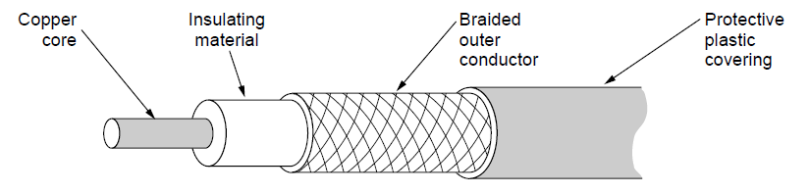
Coaxial Cable
A coaxial cable

Slide 37
Power Lines
Power lines have been used by electricity companies for low-rate communication such as remote metering for many years
Renewed interest in high-rate communication over power lines
Inside homes as a LAN
Outside for broadband Internet access
Convenience
Plug a TV and a receiver into the wall, and they can send and receive movies over the electrical wiring.
The data signal is superimposed on the low-frequency power signal

Slide 38
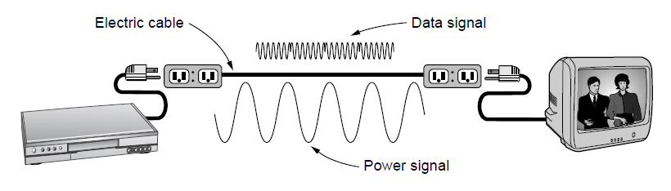
Power Lines
A network that uses household electrical wiring.

Slide 39
Power Lines
Difficulty
The power lines are designed to distribute low-frequency electrical signals (50-60Hz), and the wiring attenuates the higher frequency (MHz) for high-rate data transmission
Susceptible to electrical noise, e.g., switch on and off appliances
Radiate signals that may cause interference

Slide 40
Fiber Optics
For long-haul transmission in network backbones, high-speed LANs, and high-speed Internet access such as FttH (Fiber to the Home)
An optical transmission system:
The light source
A pulse of light is bit 1
The absence of light is bit 0
The transmission medium
An ultra-thin fiber of glass
The detector
Produce an electrical pulse when light falls on it
Accept an electrical signal, converts and transmits it by light pulses, and reconverts the output to an electrical signal

Slide 41
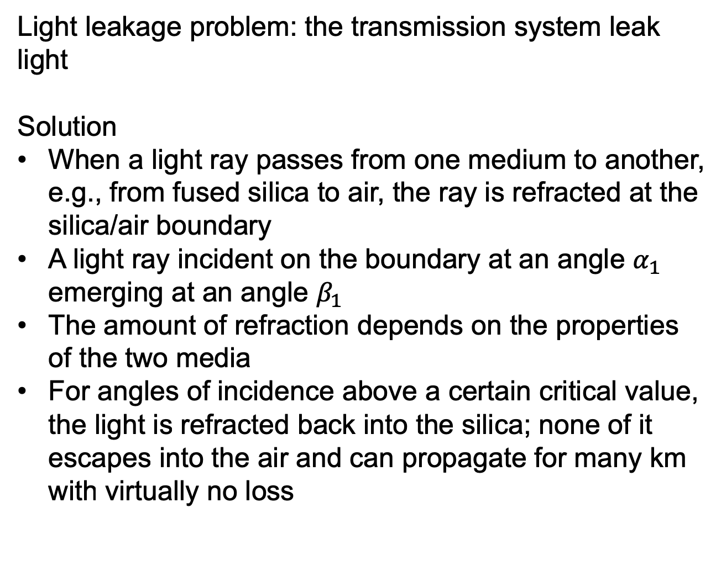
Fiber Optics
Light leakage problem: the transmission system leak light
Solution
When a light ray passes from one medium to another, e.g., from fused silica to air, the ray is refracted at the silica/air boundary
A light ray incident on the boundary at an angle $α_{1}$ emerging at an angle $β_{1}$
The amount of refraction depends on the properties of the two media
For angles of incidence above a certain critical value, the light is refracted back into the silica; none of it escapes into the air and can propagate for many km with virtually no loss

Slide 42
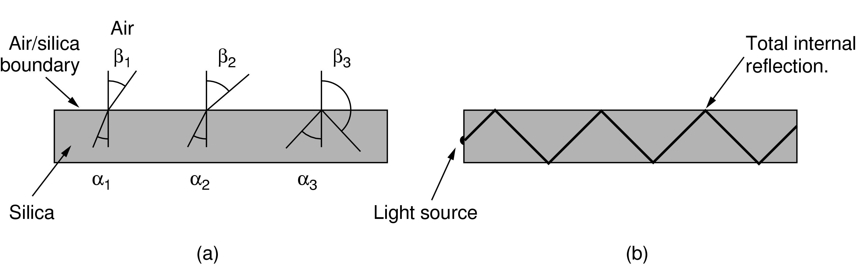
Fiber Optics (2)
Light trapped by total internal reflection.

Slide 43
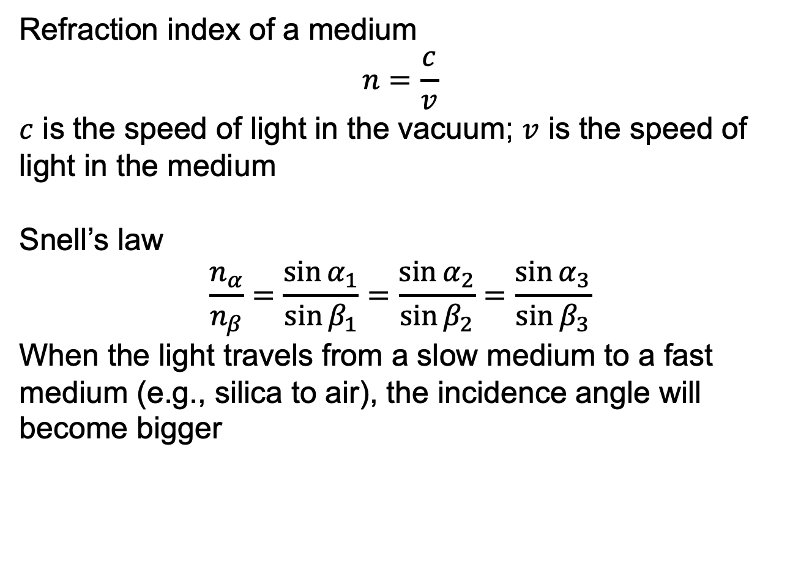
Fiber Optics
Refraction index of a medium
$$n=\frac{c}{v}$$
$c$ is the speed of light in the vacuum; $v$ is the speed of light in the medium
Snell’s law
$$\frac{n_{α}}{n_{β}}=\frac{\sin{α_{1}}}{\sin{β_{1}}}=\frac{\sin{α_{2}}}{\sin{β_{2}}}=\frac{\sin{α_{3}}}{\sin{β_{3}}}$$
When the light travels from a slow medium to a fast medium (e.g., silica to air), the incidence angle will become bigger

Slide 44
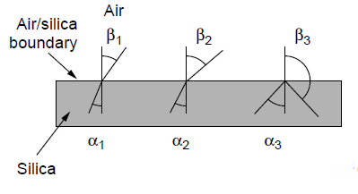
Fiber Optics
Three examples of a light ray from inside a silica fiber impinging on the air/silica boundary at different angles.

Slide 45
Fiber Optics
Multimode fiber
Many different rays can be transmitted simultaneously at different angles
Single-mode fiber
The fiber’s diameter is reduced to a few wavelength of light, and the light can propagate only in a straight line without bouncing.
Longer distances
100 Gbps for 100 km without amplification

Slide 46
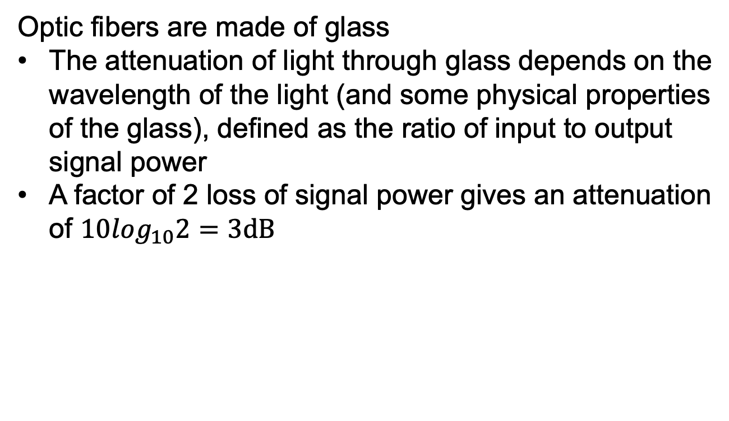
Fiber Optics
Optic fibers are made of glass
The attenuation of light through glass depends on the wavelength of the light (and some physical properties of the glass), defined as the ratio of input to output signal power
A factor of 2 loss of signal power gives an attenuation of $10\log_{10}2=3dB$

Slide 47
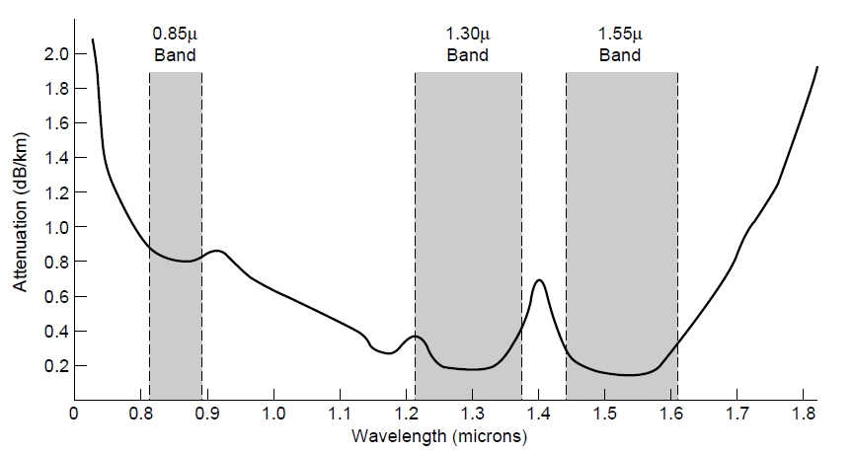
Transmission of Light Through Fiber
Attenuation of light through fiber in the infrared region

Slide 48
Fiber Optics
Three wavelength bands are most commonly used
0.85 micron
First used
Higher attenuation
Shorter distances
1.30 micron and 1.55 micron
Good attenuation properties

Slide 49
Fiber Optics
Chromatic dispersion
Light pulses spread out as they propagate
Wavelength dependent
Spread-out pulses may overlap
Solution 1: Increase the distance between pulses
Solution 2: Make the pulses in a special shape to cancel out the dispersion

Slide 50
Fiber Cables
Similar to coaxial cables
Glass core, typically 50 microns in diameter in multimode fibers, about the thickness of a human hair, and 8~10 micros in single-mode fibers
Glass cladding, with a lower index of refraction than the core
Plastic jacket to protect the cladding.
Grouped in bundles, protected by an outer sheath

Slide 51
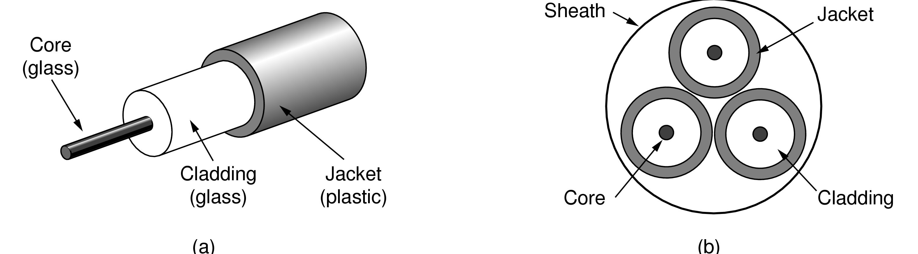
Fiber Cables
Views of a fiber cable

Slide 52
Fiber Cables
Two kinds of common light sources
LEDs (Light emitting Diodes)
Semiconductor lasers
The wavelength can be selected using Fabry-Perot or Mach-Zehnder interferometers
The detector consists of a photodiode, which gives off an electrical pulse when struck by light
The response time of diodes limits data rates to about 100 Gbps
The pulse of light must carry enough energy to be detected due to thermal noise

Slide 53
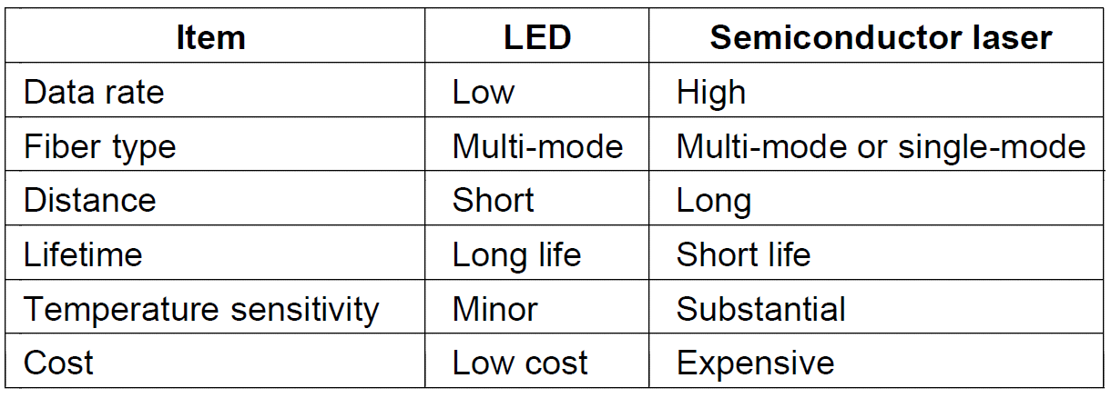
Fiber Cables
A comparison of semiconductor diodes and LEDs as light sources

Slide 54
Fiber Cables vs Copper Wire
Fiber advantages over copper wire
Much higher bandwidth
Low attenuation
Cost saving; repeaters every 50 km versus every 5 km for copper wire
Not affected by power surges, electromagnetic interference, or power failure
Not affective by corrosive chemicals
Thin and lightweight
1000 twisted pairs 1 km long weigh 8000 kg
Two fibers with the same capacity weigh 100 kg
Low installation cost
Secure; Do not leak light and are difficult to tap

Slide 55
Fiber Cables vs Copper Wire
Fiber disadvantages:
Require more advanced skills
Damaged easily by being bent too much
Fiber interfaces is more expensive than electrical interfaces

Slide 56
Wireless Transmission
The Electromagnetic Spectrum
Radio Transmission
Microwave Transmission
Infrared Transmission
Light Transmission

Slide 57
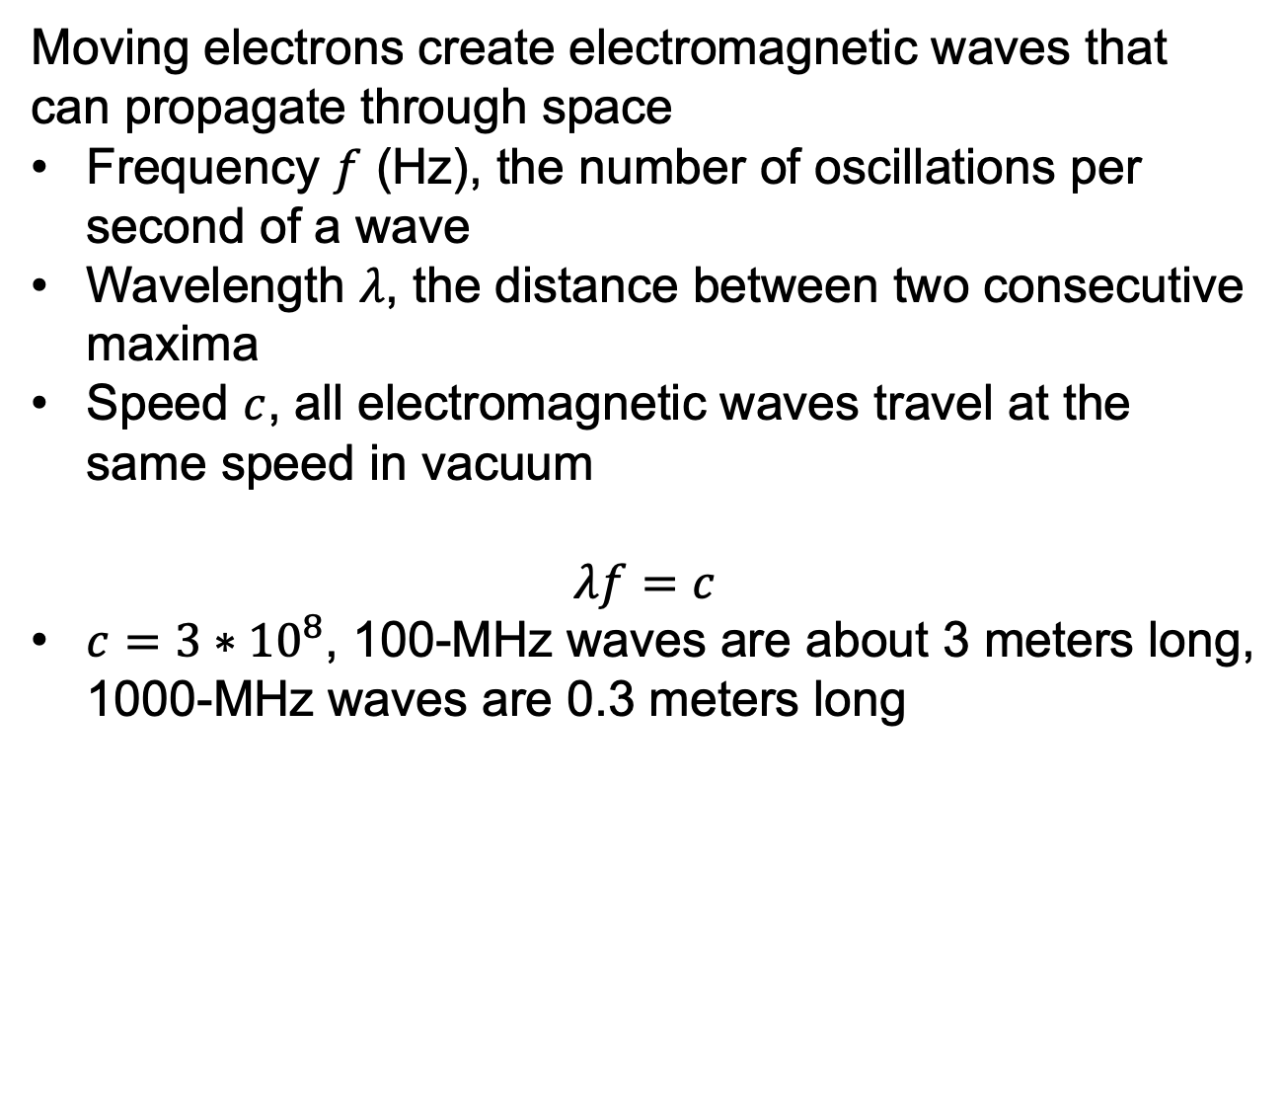
The Electromagnetic Spectrum
Moving electrons create electromagnetic waves that can propagate through space
Frequency $f$ (Hz), the number of oscillations per second of a wave
Wavelength $λ$, the distance between two consecutive maxima
Speed $c$, all electromagnetic waves travel at the same speed in vacuum
$$λf=c$$
$c=3∗{10}^{8}$, 100-MHz waves are about 3 meters long, 1000-MHz waves are 0.3 meters long

Slide 58
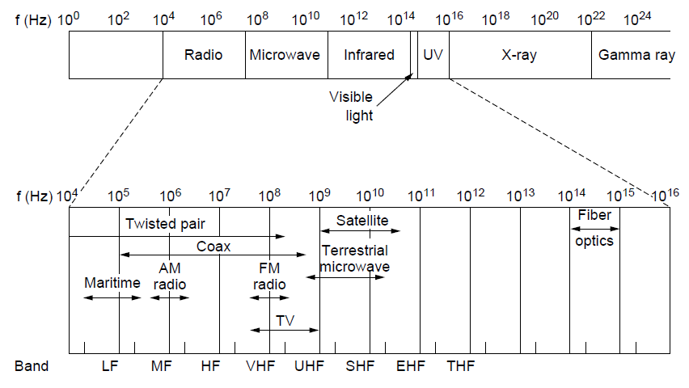
The Electromagnetic Spectrum
The electromagnetic spectrum and its uses for communication

Slide 59
The Electromagnetic Spectrum
The radio, microwave, infrared and visible light can be used for transmission.
The ultraviolet light, X-rays, and gamma rays are hard to produce and modulate, do not propagate well through buildings, and are dangerous to living things
ITU official names:
LF, low frequency
MF, medium frequency
HF, high frequency
VHF, UHF, SHF, EHF, THF, Very, Ultra, Super, Extremely and Tremendously High Frequency

Slide 60
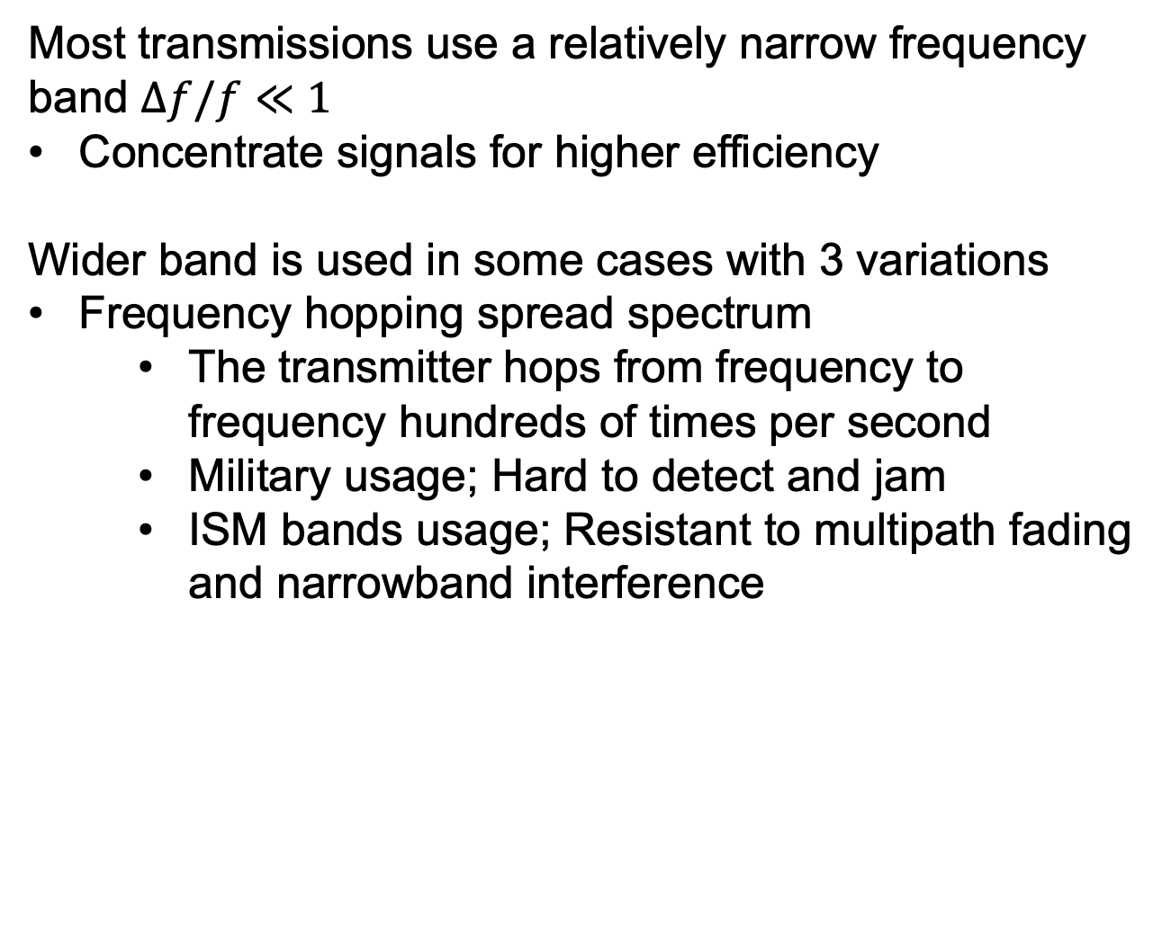
The Electromagnetic Spectrum
Most transmissions use a relatively narrow frequency band $∆f/f≪1$
Concentrate signals for higher efficiency
Wider band is used in some cases with 3 variations
Frequency hopping spread spectrum
The transmitter hops from frequency to frequency hundreds of times per second
Military usage; Hard to detect and jam
ISM bands usage; Resistant to multipath fading and narrowband interference

Slide 61
The Electromagnetic Spectrum
Wider band is used in some cases with 3 variations
Frequency hopping spread spectrum
Direct sequence spread spectrum
Spread the data signal over a wider frequency band
Let multiple signals share the same frequency band
Tolerate narrowband interference and multipath fading

Slide 62
The Electromagnetic Spectrum
Wider band is used in some cases with 3 variations
Frequency hopping spread spectrum
Direct sequence spread spectrum
UWB (UltraWideBand)
Send a series of rapid pulses, varying their positions to communication information
Have a bandwidth of at 500MHz or at least 20% of the center frequency of the band
Tolerate interference from narrowband signals
Do not cause harmful interference to other signals due to low energy at any frequency
Application in PANs

Slide 63
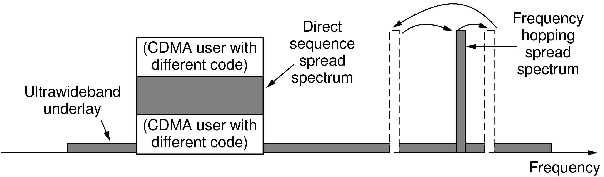
The Electromagnetic Spectrum
Spread spectrum and ultra-wideband (UWB) communication

Slide 64
The Electromagnetic Spectrum Radio Transmission
Radio frequency (RF) waves are easy to generate, can travel long distances, and can penetrate buildings easily.
Omnidirectional: travel in all directions from the source.
The transmitter and the receiver do not have to be carefully aligned physically

Slide 65
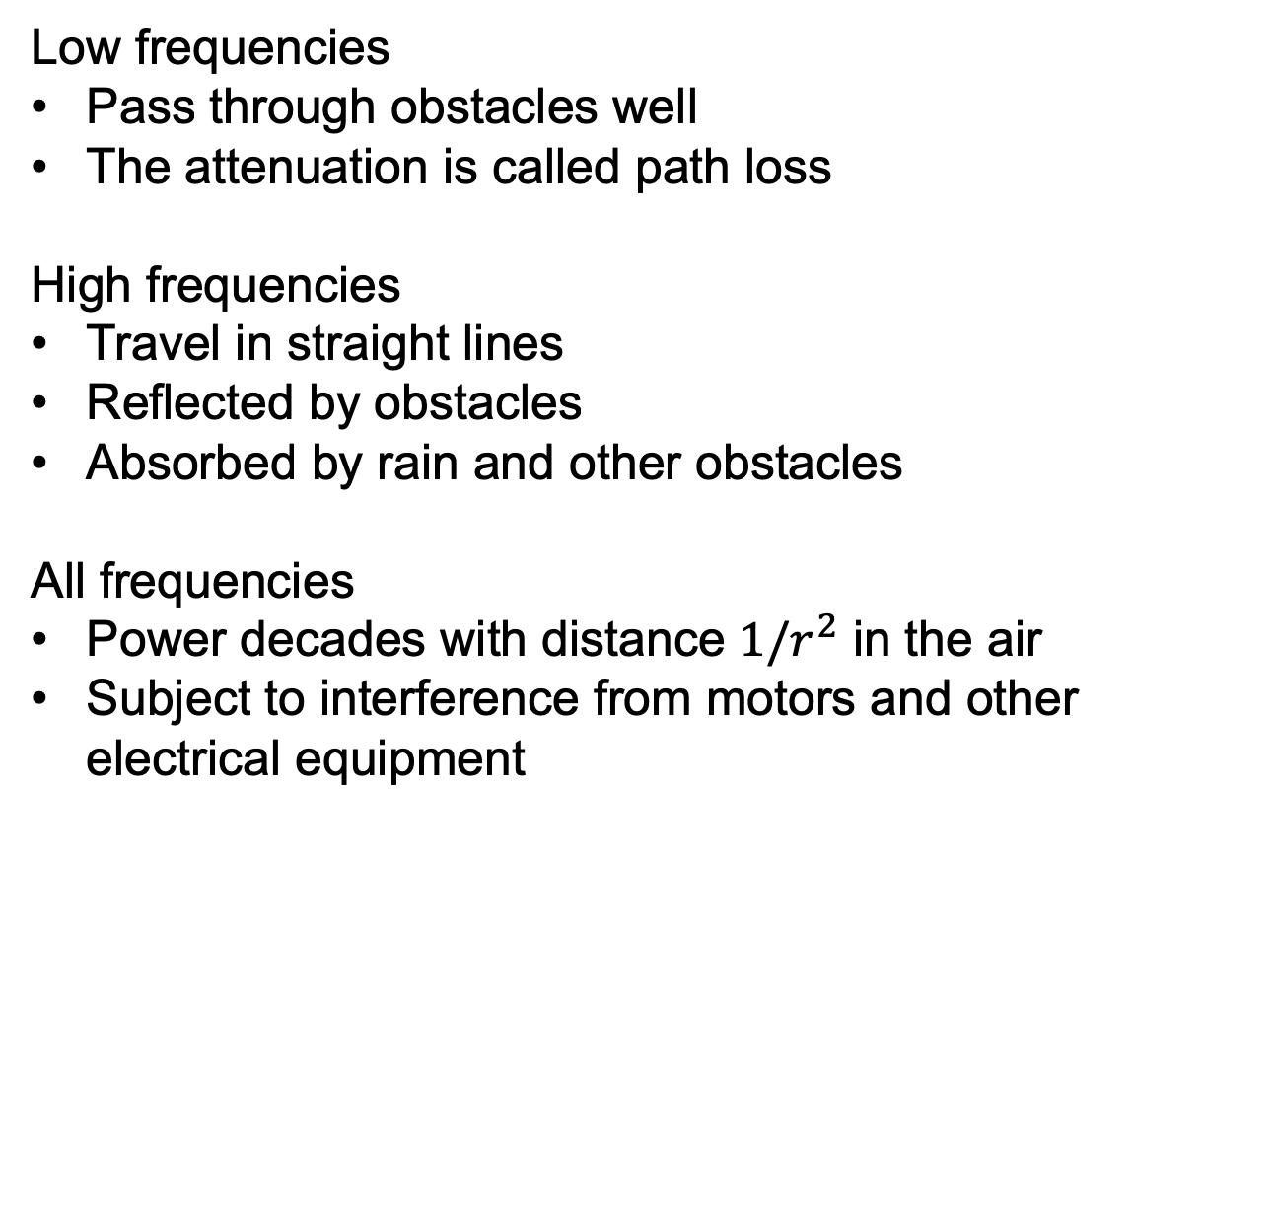
The Electromagnetic Spectrum Radio Transmission
Low frequencies
Pass through obstacles well
The attenuation is called path loss
High frequencies
Travel in straight lines
Reflected by obstacles
Absorbed by rain and other obstacles
All frequencies
Power decades with distance $1/r^{2}$ in the air
Subject to interference from motors and other electrical equipment

Slide 66
The Electromagnetic Spectrum Radio Transmission
Compared with guided media, e.g., fiber, coaxial cable and twisted pair
With the guided media, the signal drops by the same fraction per unit distance, e.g., 20 dB per 100m
With radio, the signal drops by the same fraction as the distance doubles, e.g., 6 dB per doubling in free space
Radio waves can travel long distances, interference between users is a problem

Slide 67
The Electromagnetic Spectrum Radio Transmission
In the VLF, LF and MF bands, radio waves follow the ground.
Lower frequencies have a longer transmission range
Pass through buildings easily
Low bandwidth

Slide 68
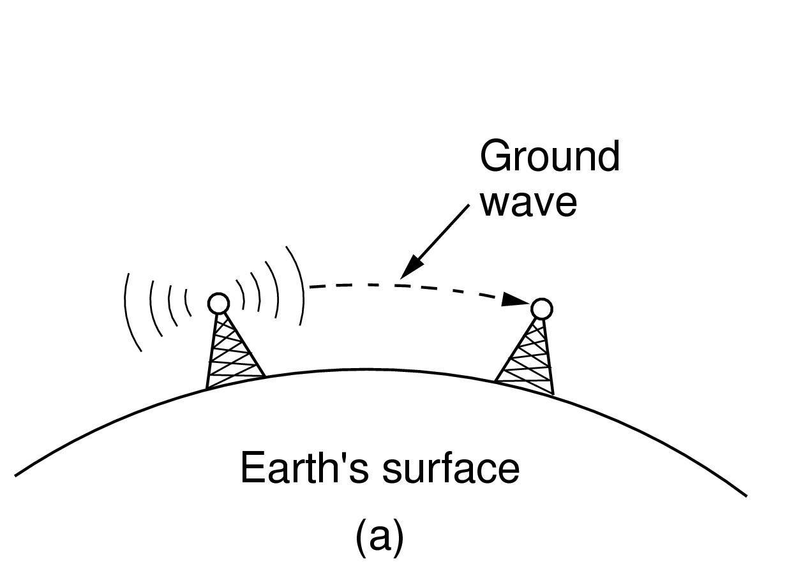
Radio Transmission
In the VLF, LF, and MF bands, radio waves follow the curvature of the earth

Slide 69
The Electromagnetic Spectrum Radio Transmission
In the HF and VHF bands, the ground waves are absorbed by the earth, but the waves will be refracted by the ionosphere and sent back to earth.
Amateur radio operators
Military use

Slide 70
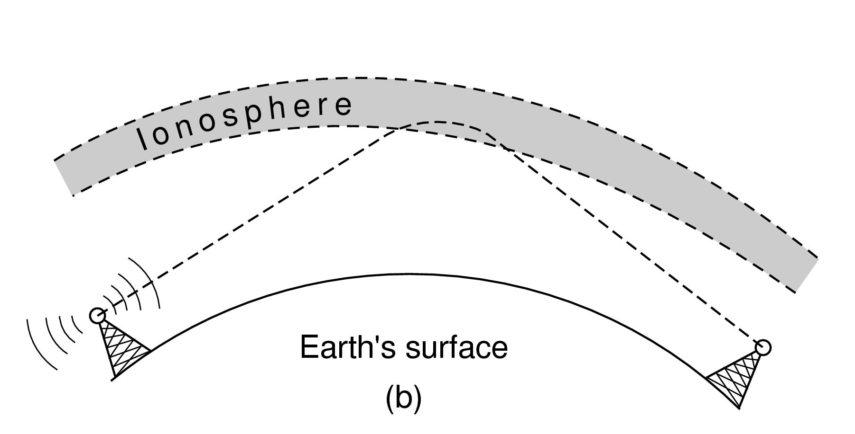
Radio Transmission
In the HF band, they bounce off the ionosphere.

Slide 71
The Electromagnetic Spectrum Microwave Transmission
Unidirectional: Microwave transmission travel in a straight line
Earth may get in the way. Repeaters are needed for long distance
The higher the towers are, the farther apart they can be
Concentrate all the energy into a small beam gives a much higher SNR
The transmitter and the receiver must be accurately aligned.
A row of transmitters can be lined up to communicate with a row of receivers.

Slide 72
The Electromagnetic Spectrum Microwave Transmission
Do not pass through buildings well.
Multipath fading
Some waves may be refracted and arrive out of phase with the direct wave and cancel the signal
Absorption by water
At 4 GHz, wavelength are only a few cm and are absorbed by rain

Slide 73
The Electromagnetic Spectrum Microwave Transmission
Application: long-distance telephone communication, mobile phones, television distribution etc.
Advantages over fiber:
Do not need to lay down cables, just need to buy a small plot of ground every 50 km and put a microwave tower on it
Relatively inexpensive.
Putting up two towers and antennas may be cheaper than burying 50 km of fiber through a congested urban area or up over a mountain

Slide 74
The Electromagnetic Spectrum Microwave Transmission
National and international agreements on who gets to use which frequencies
National governments allocate spectrum for AM and FM radio, television, mobile phones, police, maritime, navigation, military etc.
Internationally, ITU-R tries to coordinate spectrum allocation so devices can work in multiple countries

Slide 75
The Electromagnetic Spectrum Microwave Transmission
For a specific use, which carrier gets to use which frequencies
Beauty contest
Government decides which carrier’s proposal serves the public interest best
Lottery
Anyone can participate and resell the spectrum
Auction
The British government received about $40 billion for auctioning off 3G frequencies
ISM (Industrial, Scientific, Medical) bands
No allocation, everyone can transmit
Limit transmission power to minimize interference between these uncoordinated devices

Slide 76
The Electromagnetic Spectrum Microwave Transmission
The ISM bands in the U.S.
900 MHz
Early versions of 802.11, but is crowded
2.4 GHz
802.11b/g and Bluetooth
Subject to interference from microwave ovens and radar installations
5 GHz
802.11a
White spaces
Unlicensed use of around 700 MHz
Freed up due to transition from analog to all-digital television broadcasts

Slide 77
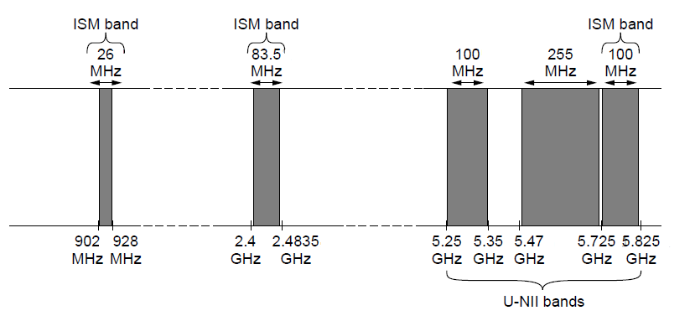
The Politics of the Electromagnetic Spectrum
ISM and U-NII bands used in the United States by wireless devices

Slide 78
The Electromagnetic Spectrum Infrared Transmission
Short-range communication
Remote control for televisions, VCRs and stereos
Relatively directional, cheap and easy to build
Do not pass through solid objects
An infrared system in one room will not interfere with another system in adjacent rooms
Secure against eavesdropping
Do not need license

Slide 79
The Electromagnetic Spectrum Light Transmission
Connect the LANs in two buildings via lasers mounted on rooftops
Pros
Unidirectional, high bandwidth, low cost, relatively secure (hard to tap a narrow laser beam)
Cons
Wind and temperature changes can distort the laser beam
Cannot penetrate rain or thick fog
Application: ubiquitous computing
Data communication between cameras and displays

Slide 80

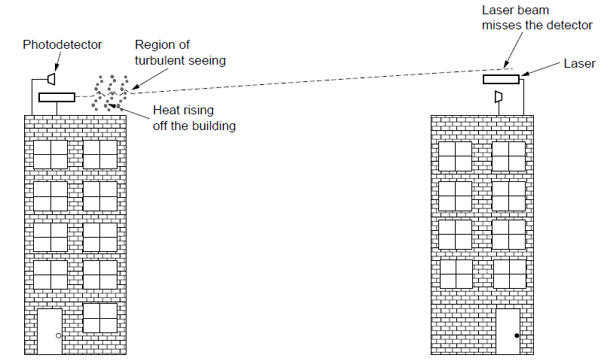
Light Transmission
Convection currents can interfere with laser communication systems. A bidirectional system with two lasers is pictured here.

Slide 81
Communication Satellites
A communication satellite contains several transponders
Each transponder listens to some portion of the spectrum, amplifies the incoming signal, and rebroadcasts it at another frequency to avoid interference with the incoming signal
Kepler’s law
The higher the satellite, the longer the orbital period;
Low-orbit satellites pass out of view quickly, so more are needed to provide continuous coverage
Van Allen belts
Layers of highly charged particles trapped by the earth’s magnetic field, will destroy satellites

Slide 82
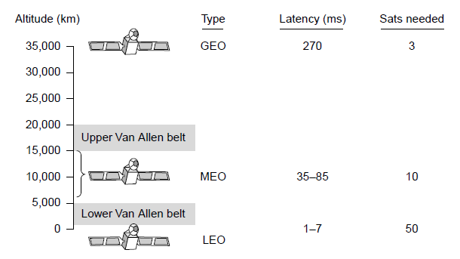
Communication Satellites
Communication satellites, some properties, including: altitude above earth, round-trip delay time, number of satellites for global coverage.

Slide 83
Communication Satellites
Geostationary Satellites
Medium-Earth Orbit Satellites
Low-Earth Orbit Satellites
Satellites Versus Fiber

Slide 84
Geostationary Satellites
GEO (Geostationary Earth Orbit) satellites
At an altitude of about 35,800 km, the orbit period is 24 hours
To avoid interference, geostationary satellites are spaced no less than 2 degrees in the 360-degree equatorial plane
Only 360/2 = 180 in the sky
Each transponder can use multiple frequencies and polarizations

Slide 85
Geostationary Satellites
Orbit slots to place GEO satellites
Allocated by ITU
Station keeping
The effects of solar, lunar and planetary gravity tend to move the satellites away from their orbit slots
Countered by on-board rocket motors
When the fuel is exhausted, the satellite will reenter the atmosphere and burn up

Slide 86
Geostationary Satellites
Frequencies
ITU allocated certain frequency bands to satellite users
Uplink and downlink traffic
C, S, L bands are first designated, but are narrow and crowded
Ku band can allow satellites to be spaced as close as 1 degree, but will be absorbed by rain
Ka band requires equipment that is expensive

Slide 87
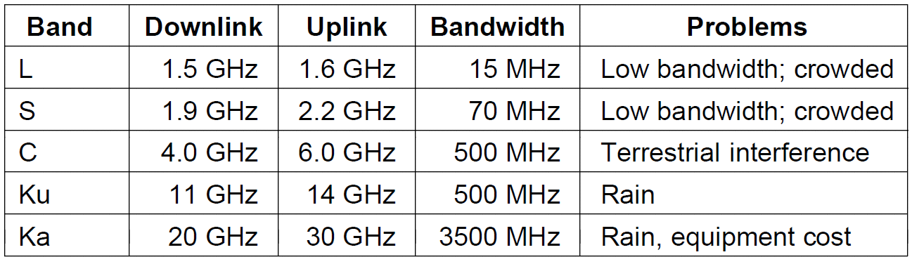
Geostationary Satellites
The principal satellite bands

Slide 88
Geostationary Satellites
Each satellite is equipped with multiple antennas and multiple transponders
Each downward beam can be focused on a small geographical area, so multiple upward and downward transmissions can take place simultaneously

Slide 89
Geostationary Satellites
VSATs (Very Small Aperture Terminals)
Microstations that have 1-meter or smaller antennas (versus 10 m for a standard GEO antenna)
Uplink is up to 1 Mbps, downlink is several Mbps
Due to its lower power, VSAT microstations cannot directly communicate with each other via satellites
Hub is a special station with a large, high-gain antenna to relay traffic between VSATs
Longer delay, cheaper end-user stations
Potential use in rural areas

Slide 90
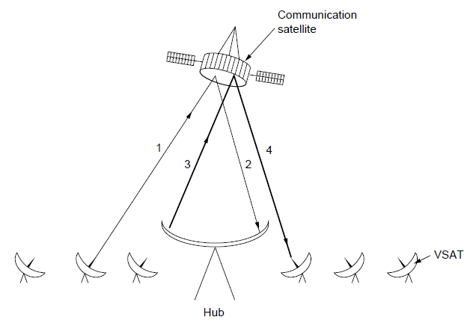
Geostationary Satellites
VSATs using a hub.

Slide 91
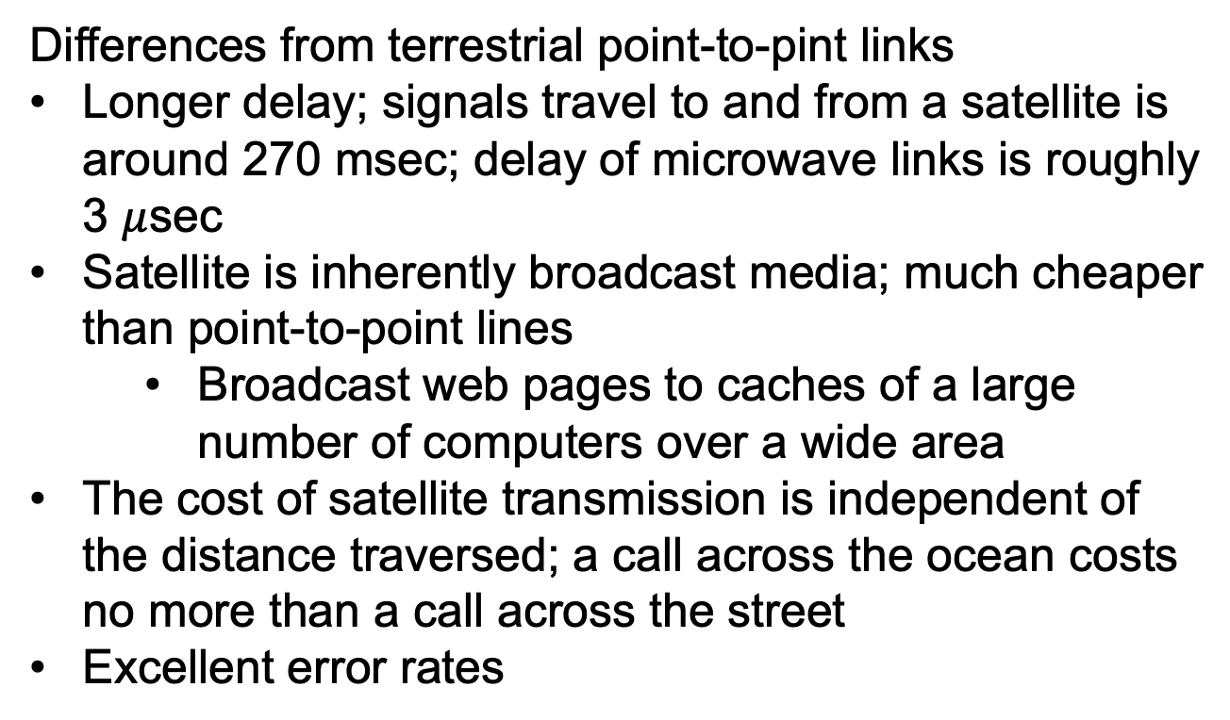
Geostationary Satellites
Differences from terrestrial point-to-pint links
Longer delay; signals travel to and from a satellite is around 270 msec; delay of microwave links is roughly 3 $μ$sec
Satellite is inherently broadcast media; much cheaper than point-to-point lines
Broadcast web pages to caches of a large number of computers over a wide area
The cost of satellite transmission is independent of the distance traversed; a call across the ocean costs no more than a call across the street
Excellent error rates

Slide 92
Medium-Earth Orbit Satellites
MEO (Medium-Earth Orbit) satellites
Between the two Van Allen belts
6 hours to circle the earth
Lower than the GEOs, require less powerful transmitters to reach the satellites
Used for navigation systems rather than communications
Applications: 30 GPS (Global Positioning System) satellites orbiting at about 20,200 km

Slide 93
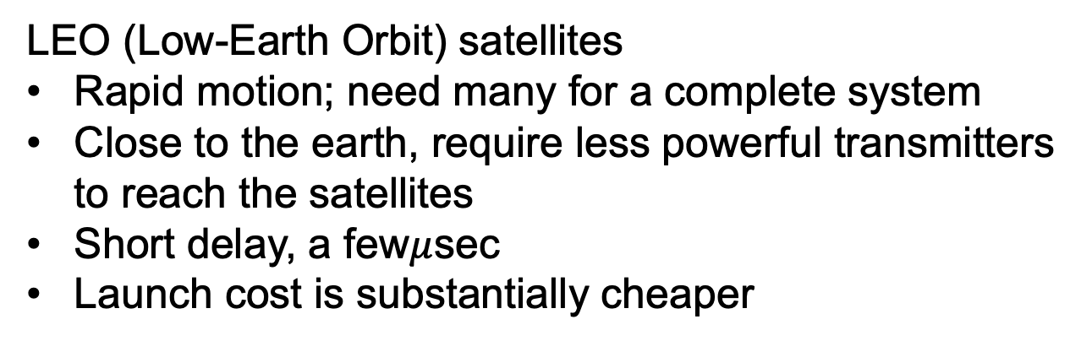
Low-Earth Orbit Satellites
LEO (Low-Earth Orbit) satellites
Rapid motion; need many for a complete system
Close to the earth, require less powerful transmitters to reach the satellites
Short delay, a few$μ$sec
Launch cost is substantially cheaper

Slide 94
Low-Earth Orbit Satellites
The Iridium project
In 1990, Motorola asked FCC for permission to launch 77 low-orbit satellites (element 77 is iridium)
The plan was later revised to use only 66 satellites
The idea was that as soon as one satellite went out of view, another would replace it.
The Iridium satellites are positioned at an altitude of 750 km, in circular polar orbits.
Arranged in north-south necklaces, with one satellite every 32 degrees of latitude
With 6 necklaces the entire earth is covered

Slide 95
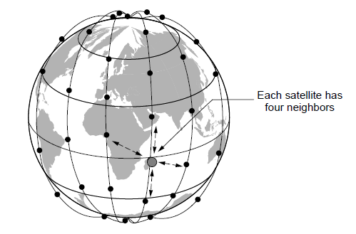
Low-Earth Orbit Satellites
The Iridium satellites form six necklaces around the earth.

Slide 96
Low-Earth Orbit Satellites
Iridium project:
The communication between distant customers takes place in space
Globalstar project:
An alternative to the Iridium project.
Based on 48 LEO satellites
The call is sent to the satellite, and is sent back to the earth, relayed by a terrestrial network to the ground station nearest the callee
Put the complexity on the ground, easier to manage

Slide 97
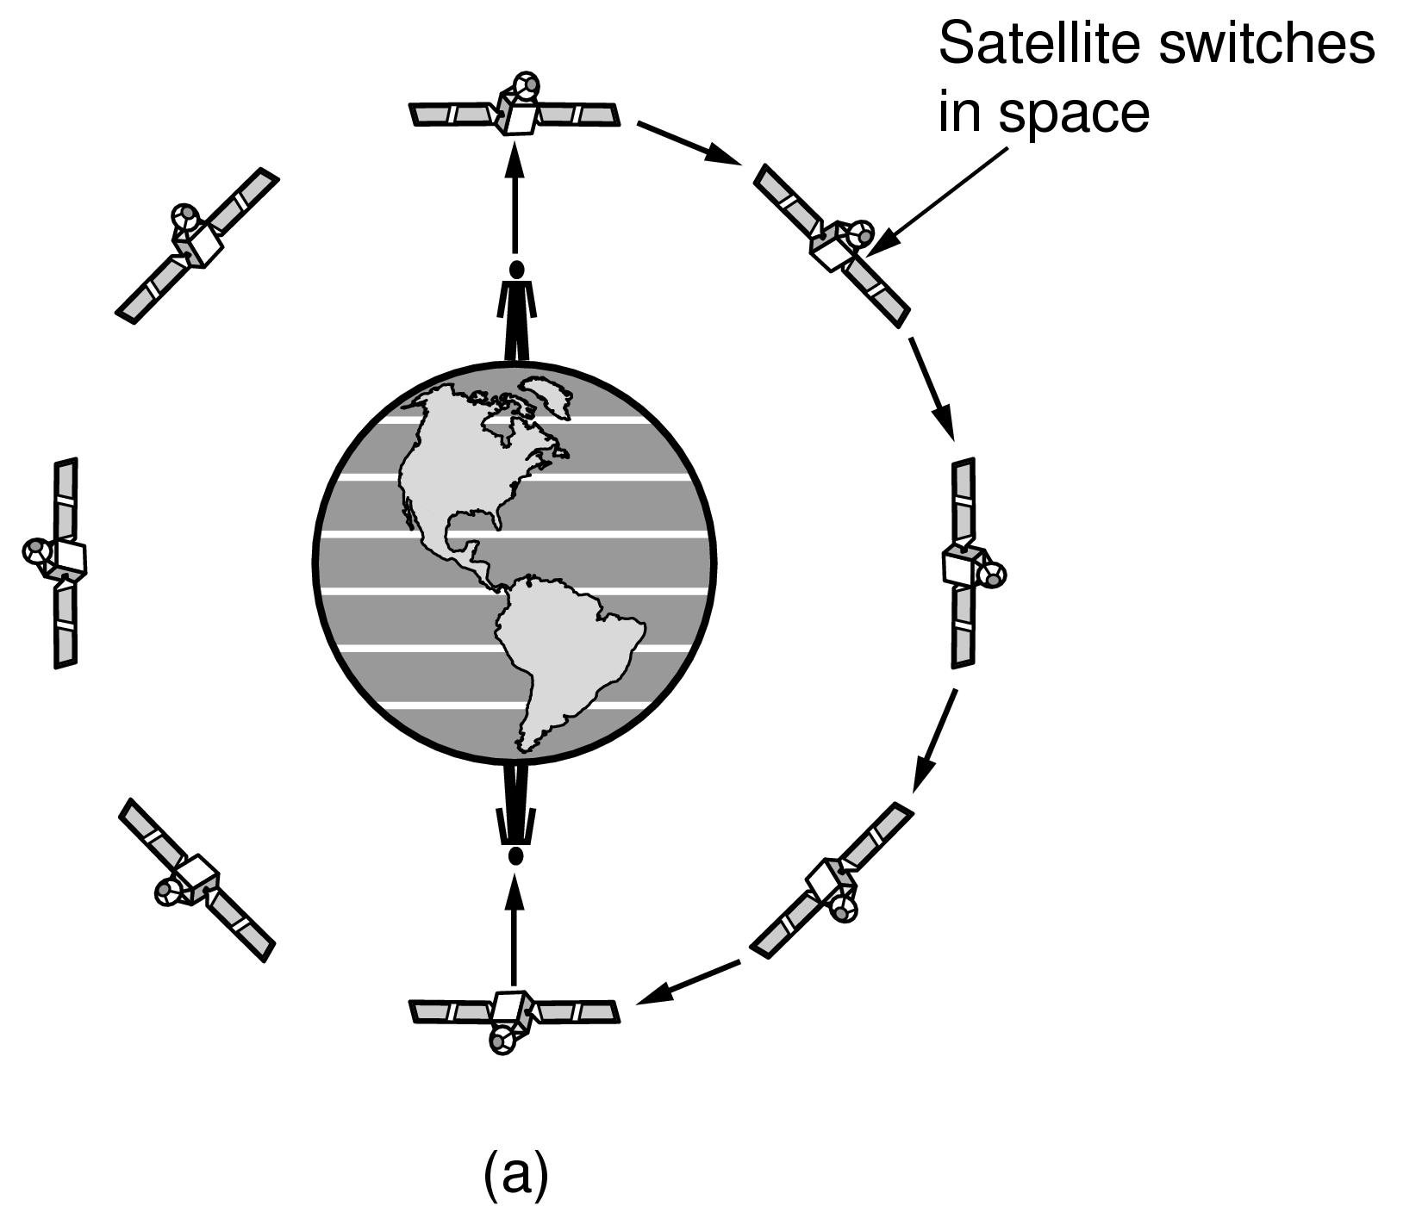
Low-Earth Orbit Satellites
Relaying in space.

Slide 98
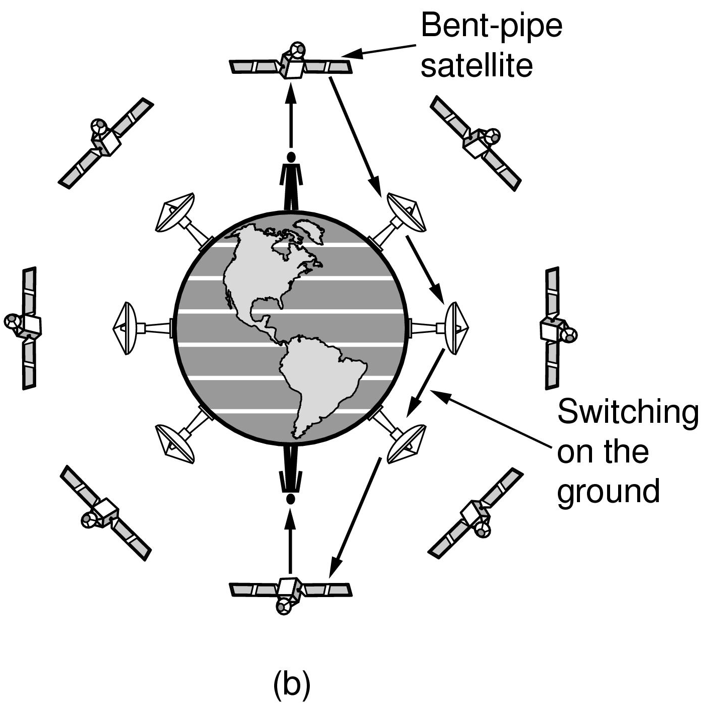
Low-Earth Orbit Satellites
Relaying on the ground

Slide 99
Satellites versus Fiber
Advantages of satellites over fiber
Rapid deployment
A quick response is useful for military communication systems in times of war and disaster response in times of peace
Communication in places where the terrestrial infrastructure is poorly developed
At sea
In the desert
South/North Pole
Island countries, e.g., Indonesia
Broadcasting
A message sent by satellite can be received by thousands of ground stations at once
Digital TV and radio broadcasting

Slide 100
End
Chapter 2

